Slide 1



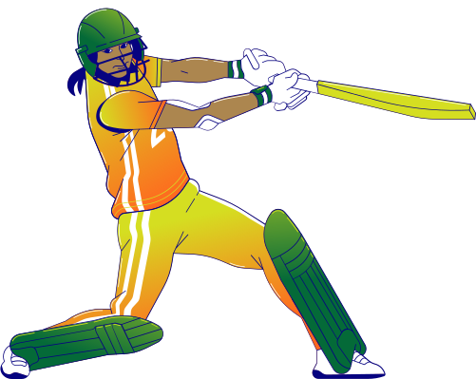
Detailed Insights and Predictions for IPL 2024
UMANG SHARMA
Attribute –
PPT Template - : Canva

Slide 2

























IPL OVERVIEW
NUMBER OF TEAMS TEN ( 10 )
ADMINISTRATOR BCCI
( Board of Control for Cricket in India )
FORMAT
CHENNAI SUPER KINGS
MUMBAI INDIANS
DELHI CAPITALS
PUNJAB KINGS
GUJRAT TITANS
RAJASTHAN ROYALS
KOLKATA KNIGHT RIDERS
ROYAL CHALLENGERS
BANGALORE
LUCKNOW SUPER GIANTS
SUNRISERS HYDERABAD

Slide 3










3 Year Stats
Predictions

Slide 4

TOP 10 BATSMANS

Slide 5
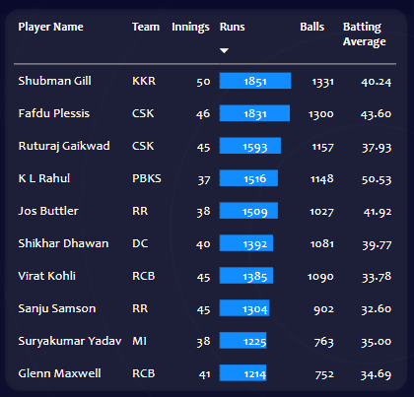

Slide 6
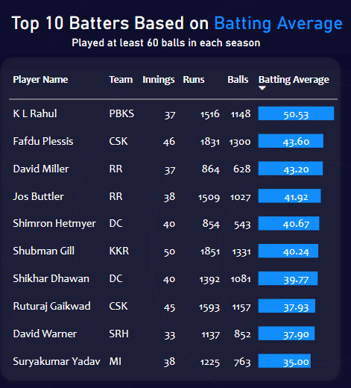
Total Runs
Strike Rate
Consistency Kings
Batting Average: Average runs scored per dismissal.

Slide 7
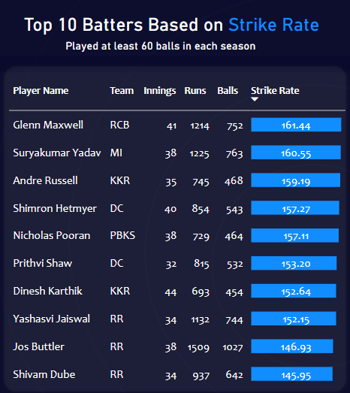
Total Runs
Batting Average
Strike Rate
Boundary %
Game Changers at the Crease

Slide 8
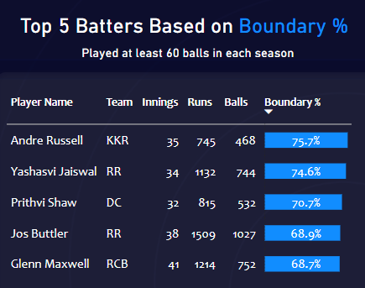
Total Runs
Batting Average
Strike Rate
Boundary %
The Battle of Aggression

Slide 9
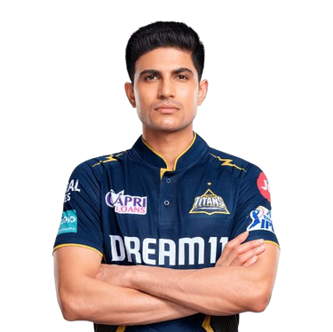


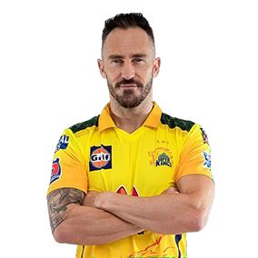

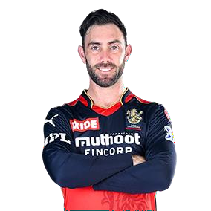
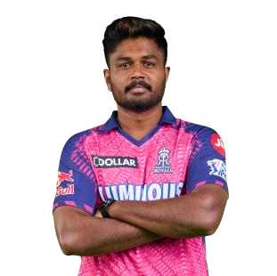
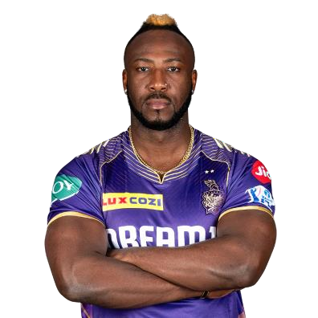
Batting Average
Strike Rate
Boundary %
Assembling the Avengers
Master Blasters: The Powerhouse Lineup!
Opener
Opener
Batter
Batter
Allrounder
Captain (wk)
Allrounder

Slide 10
TOP 10 BOWLERS

Slide 11
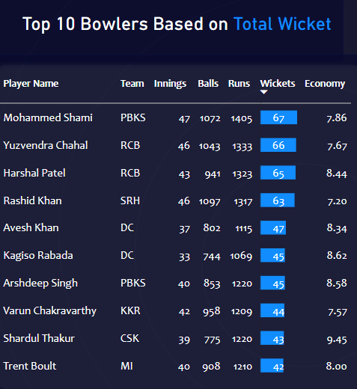

Slide 12
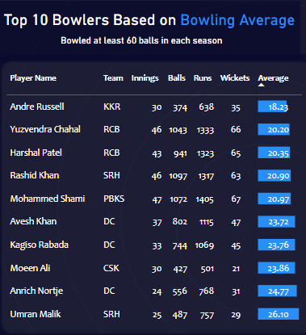

Slide 13
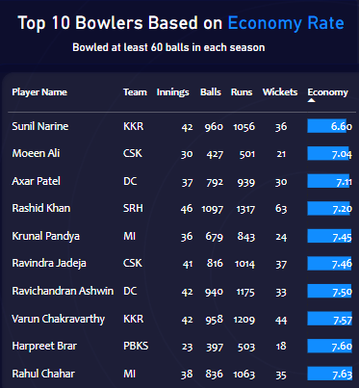
Total Wicket
Bowling Average
Dot Ball %

Slide 14
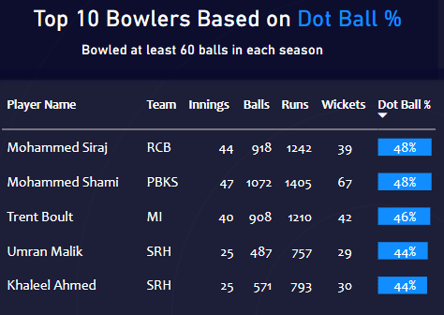
Total Wicket
Bowling Average
Economy Rate
Dot Ball %
The Battle of Accuracy

Slide 15
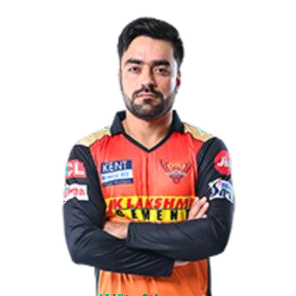
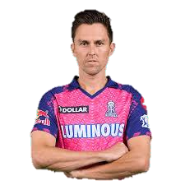
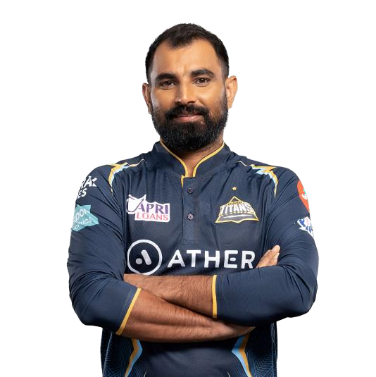
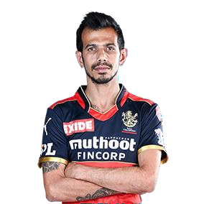
Total Wicket
Bowling Average
Economy Rate
Dot Ball %
Assembling the Avengers
Bowling Blitz: Unleashing our Lethal Line-Up!
Allrounder
Allrounder
Bowler
Bowler
Bowler
Bowler

Slide 16
TOP TEAMS

Slide 17


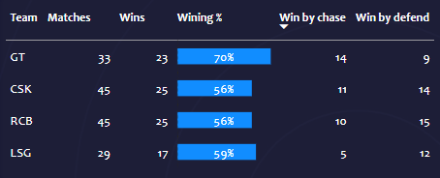
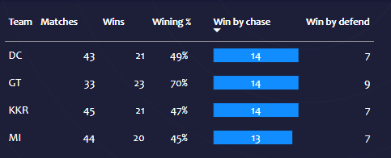





Top 4 Teams Based on Winning %
Top 2 Teams Win by Chasing

Slide 18
CAP PLAYERS

Slide 19
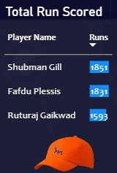
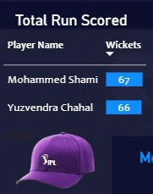
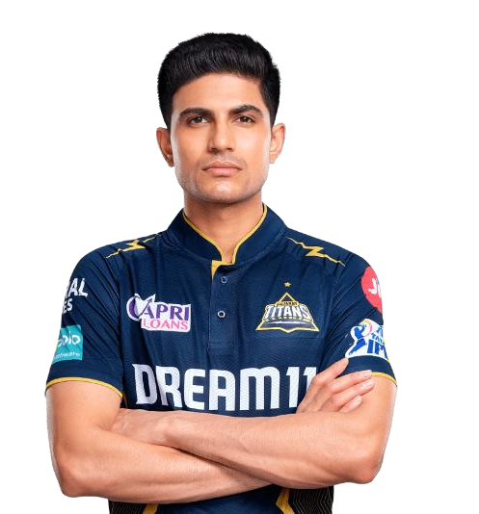
Most Runs(Orange Cap)
Top 2 Teams Win by Chasing

Slide 20
QUALIFYING TEAMS

Slide 21
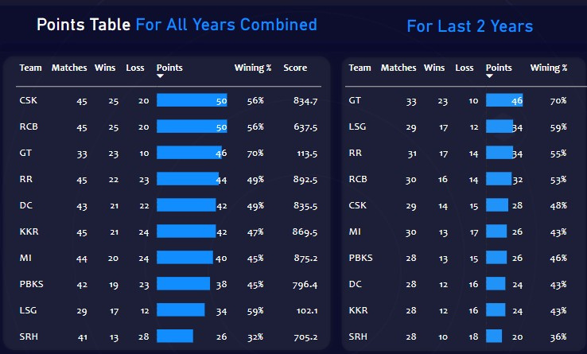



Qualifying Teams
Winner and Runnerup
Winner
Runnerup
Qualifying Teams

Slide 22
MY PLAYING XI

Slide 23
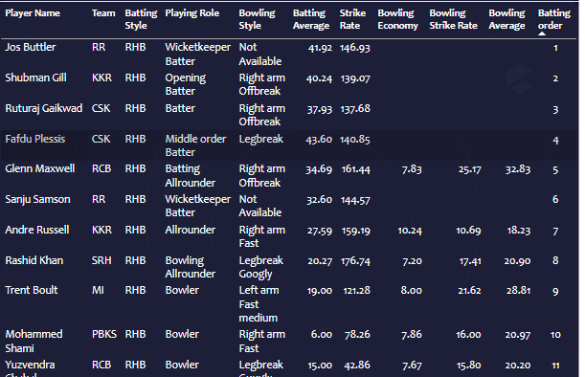
My Playing XI : The Powerhouse Lineup!
Assembling the Avengers

Slide 24
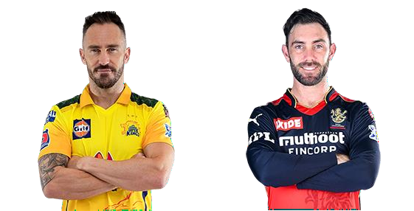
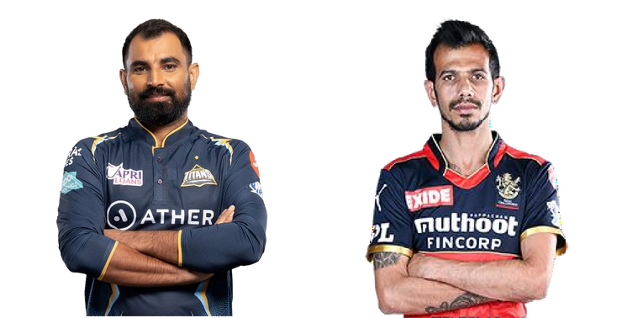
My Playing XI : The Powerhouse Lineup!
Assembling the Avengers
Opener
Opener
Batter
Batter
Allrounder
Captain (wk)
Allrounder
Bowler
Bowler
Bowler
Bowler

Slide 25
MY ALLROUNDERS

Slide 26
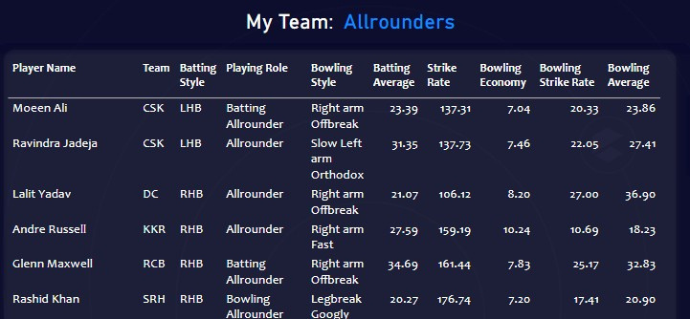
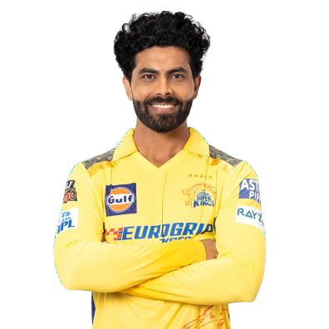
Swing and Smash: The Dynamic Do-It-Alls of Cricket!

Slide 27
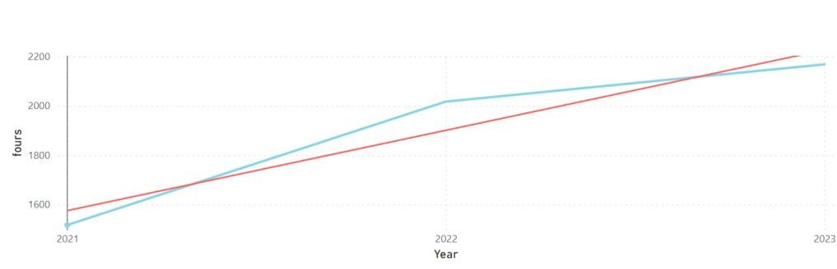
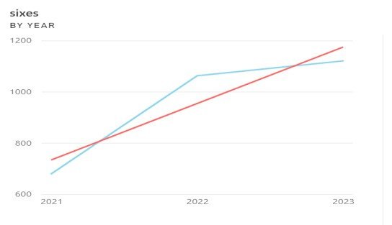
Batters
Teams
Total Fours / Year
Total Sixes / Year
Shubman Gill and Faf du Plessis emerge as the top scorers over the past three years.
In 2021, Ruturaj Gaikwad led the charts, while Jos Buttler dominated in 2022, and Shubman Gill claimed the top spot in 2023.
Shubman, Ruturaj, Jos, and Faf du Plessis stand out as the only four batsmen positioned in the top right quadrant of the scatter chart of strike rate and batting average.
While Andre Russell boasts the highest number of boundaries in his total runs, it's evident that Yashasvi Jaiswal has scored comparably and maintained a similar boundary percentage.

Slide 28
Mohammed Shami emerges as the highest wicket-taker over the combined three-year period, followed closely by Yuzvendra Chahal, who trails by just one wicket.
The leading wicket-takers for each year are as follows: Harshal Patel in 2021, Yuzvendra Chahal in 2022, and Mohammed Shami in 2023.
Andre Russell stands out for his exceptional bowling performance, having taken each wicket after conceding only 18 runs, boasting the best bowling average. Yuzvendra Chahal follows closely with an average of 20 runs per wicket.
Sunil Narine emerges as the most economical bowler, despite having a lower wicket count
compared to others.
Both Mohammed Siraj and Mohammed Shami have an impressive record of bowling dot balls,
accounting for 48% of their total deliveries.

Slide 29

THANK YOU

